Slide 1

Machine Learning
Exam 1 Review
Notes:
Guidelines
Use section headers to chunk content in your presentation.
Use the same style of section header throughout your presentation.
Keep your title to no more than 2 lines.

Slide 2
Exam 1 Review
Notes:
Guidelines
Use a title slide at the beginning of your presentation. There are 9 variations of title slides to choose from.
If you will have a series of slideshows, we recommend using the same style of title slide for each presentation.
Keep your title to no more than 2 lines.
Do not change the font style or font size of the title or subtitle.

Slide 3
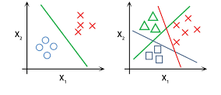
Classification
Type of problem (binary, multi-class, multi-label)
Cost functions, loss functions
Metrics
Regularization
NN Output Activations
Gradient Descent
Learning rate
Convergence vs Divergence

Slide 4



Please download and install the Slido app on all computers you use
A telecom company uses historical usage data to predict whether a specific customer will stay or cancel their subscription next month. What type of problem is this?
ⓘ Start presenting to display the poll results on this slide.

Slide 5


Do not edit How to change the design
Which of the following best describes a loss function in machine learning?
The Slido app must be installed on every computer you’re presenting from

Slide 6
Do not edit How to change the design
A Junior Analyst, "Sam," is tasked with building a model to predict whether a specific customer will stay or cancel their subscription next month. Sam uses a Large Language Model (AI) to generate the code and presents the following model to you for approval before deploying it to production. Do you consider this to be a:
The Slido app must be installed on every computer you’re presenting from

Slide 7
Do not edit How to change the design
In the provided code, the use of .toarray() to convert a sparse matrix into a dense matrix will reduce the total amount of memory (RAM) consumed by the computer because it simplifies the data structure into a standard array format.
The Slido app must be installed on every computer you’re presenting from

Slide 8
Do not edit How to change the design
What is wrong with the configuration used by Sam?
The Slido app must be installed on every computer you’re presenting from

Slide 9
Please download and install the Slido app on all computers you use
Which metric can you report for this problem?
ⓘ Start presenting to display the poll results on this slide.

Slide 10
Do not edit How to change the design
Sam is training a neural network in TensorFlow for binary classification. He runs the code here. Is there anything wrong with the setup in the compile method?
The Slido app must be installed on every computer you’re presenting from

Slide 11

Do not edit How to change the design
Sam got this error. Based on your knowledge of Matrix Algebra and the error message above, why is the code failing?
The Slido app must be installed on every computer you’re presenting from

Slide 12
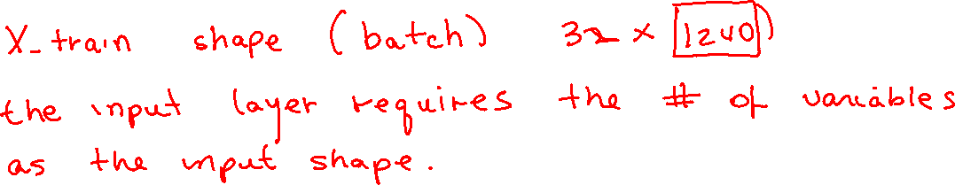

Slide 13
Please download and install the Slido app on all computers you use
A churn prediction model outputs a probability of 0.85 that a customer will churn. The actual label is 1 (the customer churned). What is the binary cross-entropy loss for this single prediction?
ⓘ Start presenting to display the poll results on this slide.

Slide 14
Please download and install the Slido app on all computers you use
You are given a model that predicts the probability of customer churn for four customers. The actual churn labels (1 = churn, 0 = no churn) and the model’s predicted probabilities are shown in the table below. What is the binary cross-entropy cost for this batch?
ⓘ Start presenting to display the poll results on this slide.

Slide 15
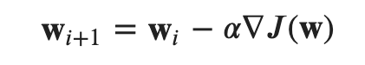
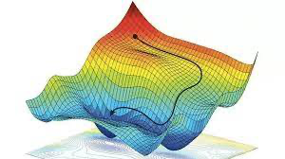
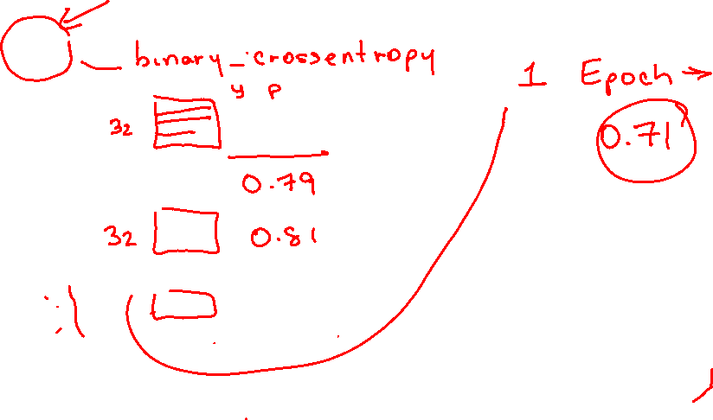

Gradient Descent Algorithm
Based on going in the direction of the decreasing gradient
$$J\left(w\right)$$

Slide 16
Please download and install the Slido app on all computers you use
What is the most likely case given the learning curve given below
ⓘ Start presenting to display the poll results on this slide.

Slide 17
Please download and install the Slido app on all computers you use
What is the most likely case given the learning curve below
ⓘ Start presenting to display the poll results on this slide.

Slide 18
Please download and install the Slido app on all computers you use
What is the most likely case given the learning curve of the model fit by Sam
ⓘ Start presenting to display the poll results on this slide.

Slide 19
Do not edit How to change the design
What do you consider the main issue why this model is overfitting?
The Slido app must be installed on every computer you’re presenting from

Slide 20
Do not edit How to change the design
You are given a model that predicts the probability of customer churn for four customers. The actual churn labels (1 = churn, 0 = no churn). The cost function for binary crossentropy is 0.79.Suppose the model has the following three weights: w = [0.8, -0.3, 1.2], and the regularization parameter alpha = 0.1, what is the total cost: J(w) + alpha*||w||_1
The Slido app must be installed on every computer you’re presenting from

Slide 21
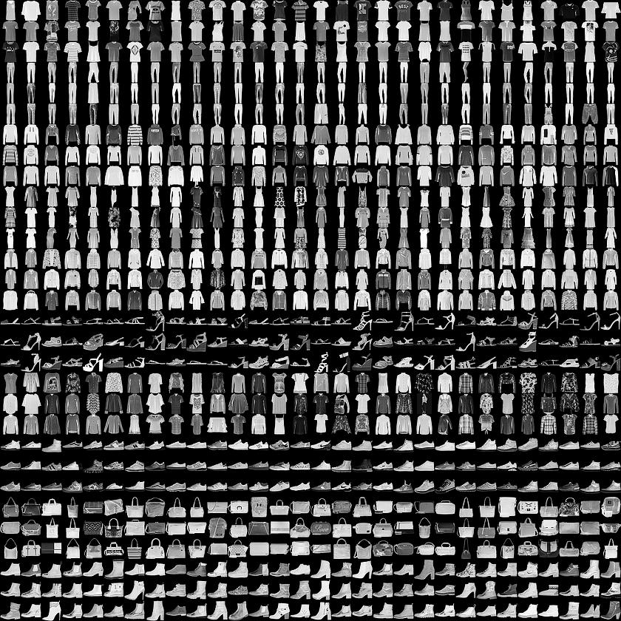
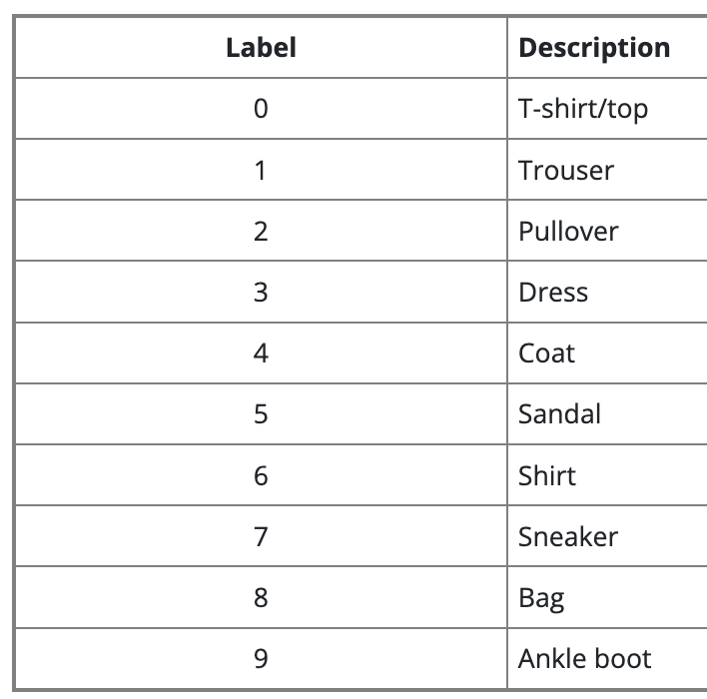
Image Classification Example

Slide 22
Please download and install the Slido app on all computers you use
What type of problem is this?
ⓘ Start presenting to display the poll results on this slide.

Slide 23
Please download and install the Slido app on all computers you use
What cost function(s) can we use?
ⓘ Start presenting to display the poll results on this slide.

Slide 24
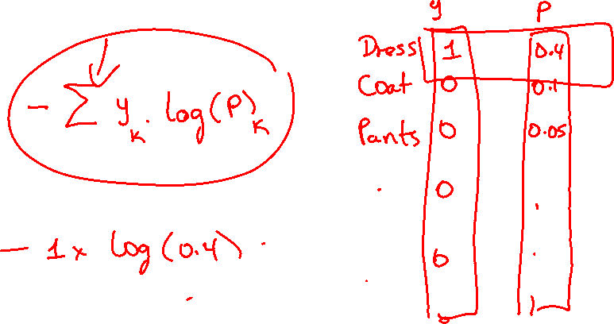

Slide 25
Please download and install the Slido app on all computers you use
A Fashion MNIST model makes the following probability predictions for an image. The true class is “Sneaker” (Class 7).
ⓘ Start presenting to display the poll results on this slide.

Slide 27
Please download and install the Slido app on all computers you use
A Fashion MNIST model makes the following probability predictions for 4 images, with the actual class labels provided.
ⓘ Start presenting to display the poll results on this slide.

Slide 28
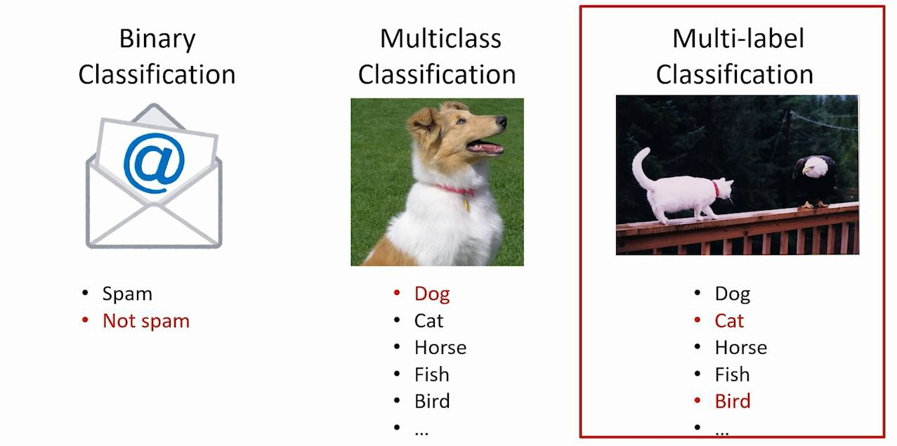
Types of Classification Problems
The 3 main classification problems are:

Slide 29
Do not edit How to change the design
Which statement best describes multilabel classification?
The Slido app must be installed on every computer you’re presenting from

Slide 30
Do not edit How to change the design
In a neural network for multilabel classification with 5 possible labels, which output layer is most appropriate?
The Slido app must be installed on every computer you’re presenting from

Slide 31
Do not edit How to change the design
A multilabel dataset has 200 observations and 7 possible labels. What is the correct shape of the target matrix Y?
The Slido app must be installed on every computer you’re presenting from

Slide 32
Do not edit How to change the design
Suppose the true labels for one observation are: [1, 0, 1, 0] and the predicted probabilities are: [0.91, 0.35, 0.62, 0.80] Using a threshold of 0.5, what is the predicted label vector?
The Slido app must be installed on every computer you’re presenting from

